Slide 1

UNIT 1; All about me
A kid’s life

Slide 2
What do you usually do during summer holidays?
What do you like doing during summer?
What do you do every day?
What do you never do in the summer?
What do you do every school day?
What do you like/hate doing on those days?
Name one thing your friend usually does on a school day and you never do.

Slide 3
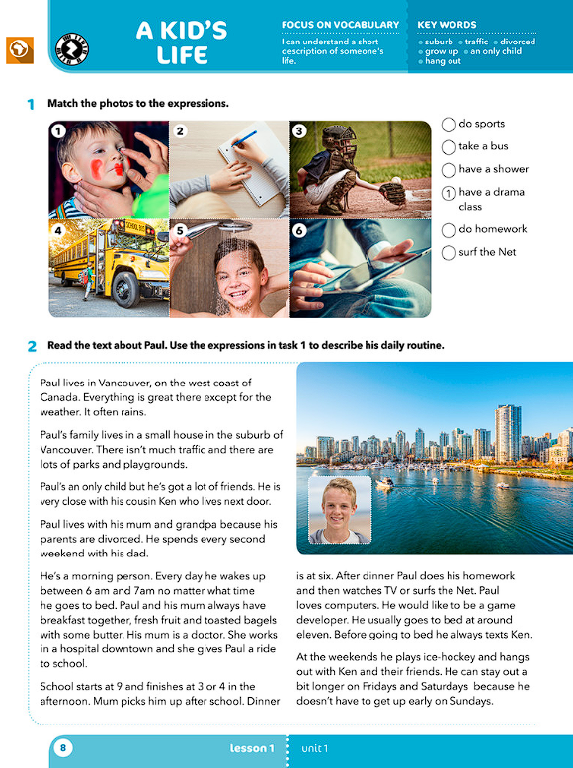
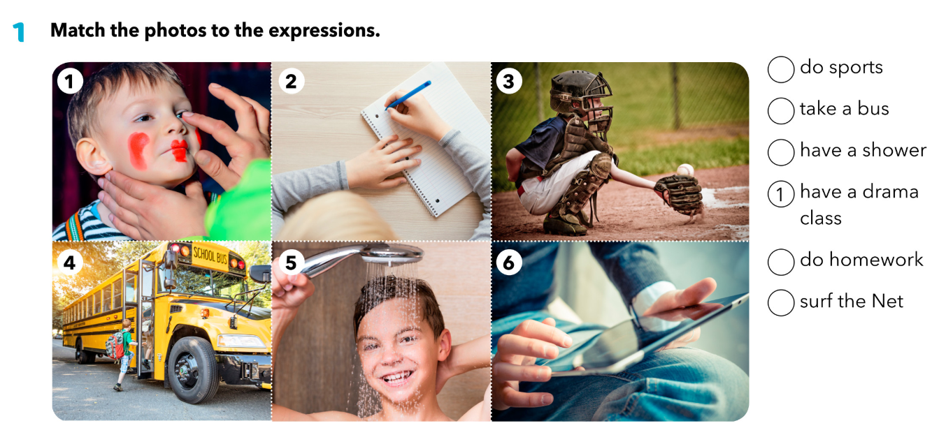
Match the photos to the expressions.
3
4
5
2
6

Slide 4
Practise!
https://wordwall.net/play/538/373/137
3
4
5
2
6

Slide 5
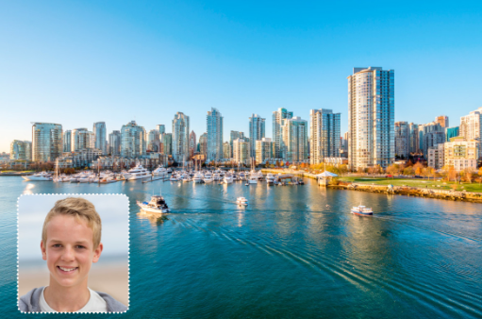
GUESS!
What is the boy’s name?
Where does he live?
When does his school start?
What does he do at the weekends?

Slide 6
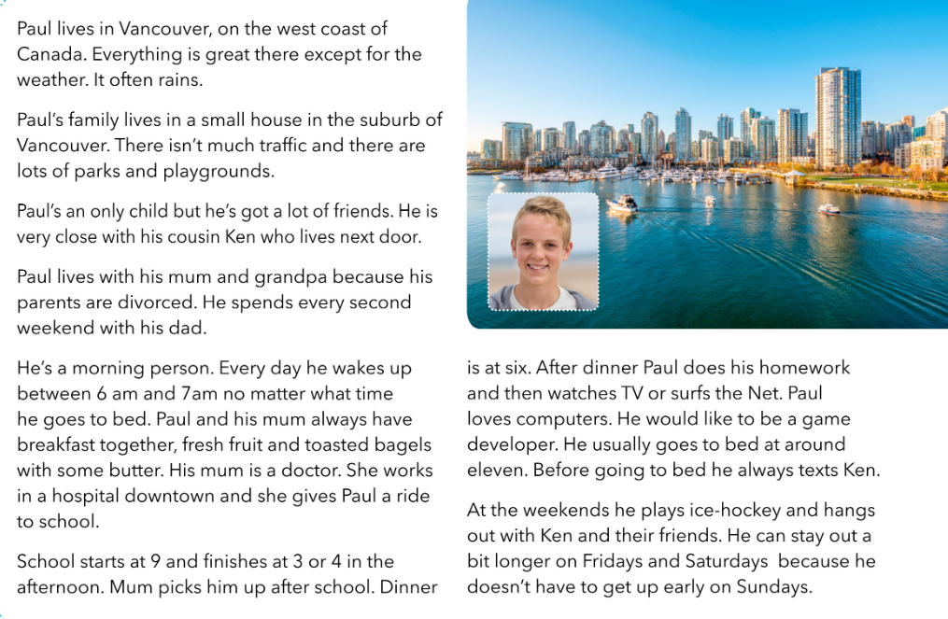
Read the text and answer the following questions.
Where does Paul live?
Who does he live with?
What does he do on school days?
What does he do at the weekends?

Slide 7
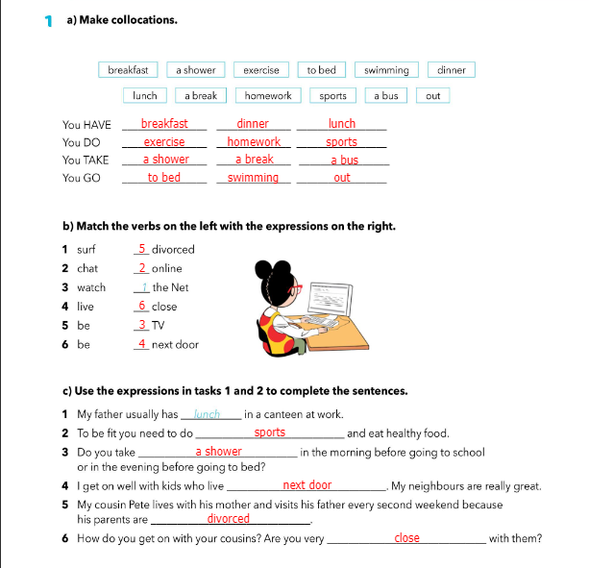
Workbook, page 6.

Slide 8
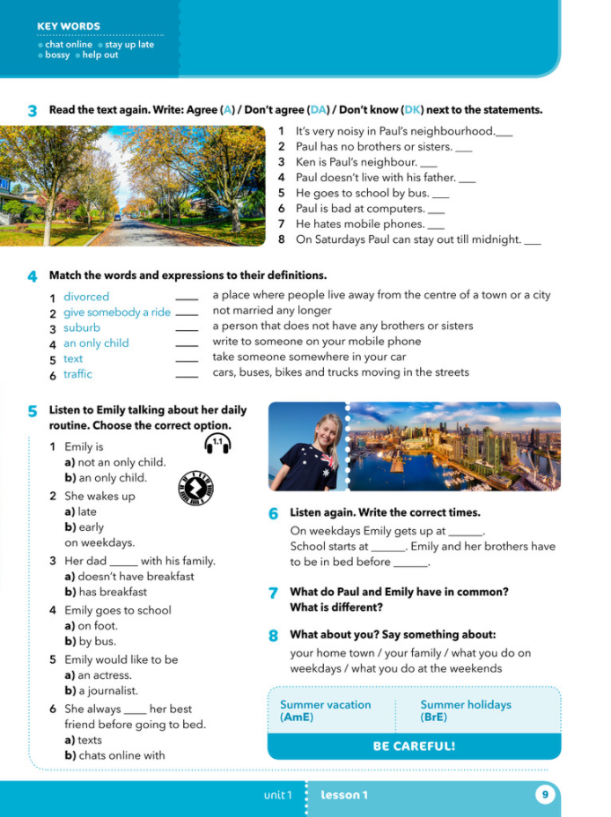
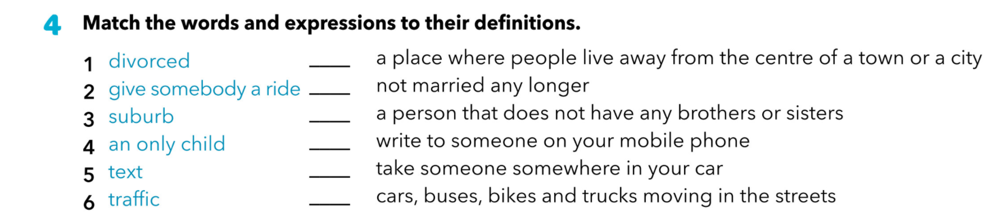
Match the the words and expressions to their definitions.
3
1
4
5
2
6
divorced rastavljeni
give somebody a ride povesti nekog
suburb predgrađe
an only child jedinac
text poslati poruku
traffic promet

Slide 9
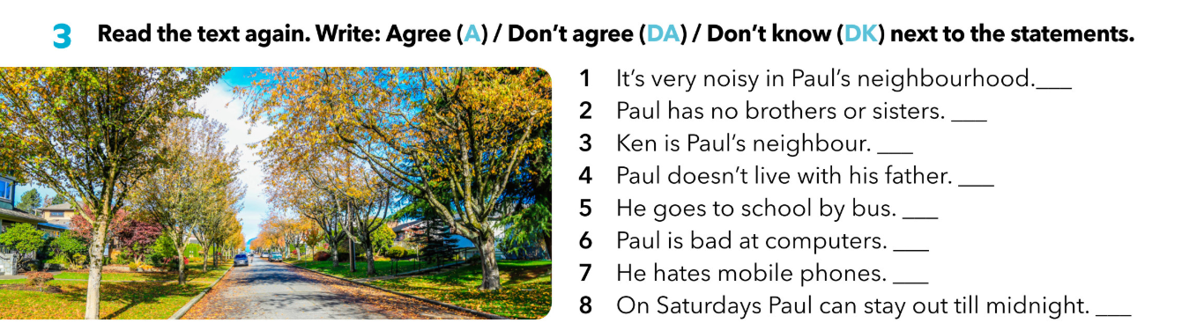
What do you remember about Paul?
Where does Paul live? Has he got any brothers or sisters? Who is Ken? What does he usually do at the weekends?
Read the text again.
Write: A (agree), DA (don’t agree), DK (don’t know) next to the statements.
DA
A
A, and a cousin
A
DA
DA
DA
DA

Slide 10
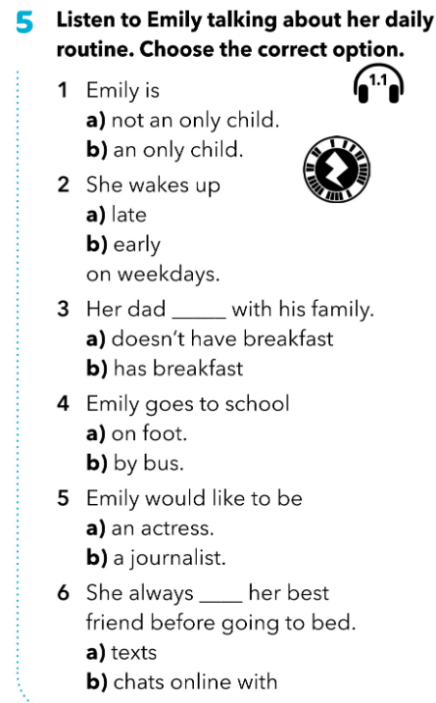


Listen to Emily talking about her daily routine. Choose the correct option.
https://www.e-sfera.hr/dodatni-digitalni-sadrzaji/a146555f-db3c-47d9-82f4-d3d49edac9cc/assets/audio/01_unit_01_lesson_1___emily_s_daily_routines.mp3
Where does Emily live?
Has she got a brother or a sister?
What does her dad do?
Who is bossy/noisy?
What does she usually do in the morning?
What does she do after school?
Who does she chat online with?

Slide 11
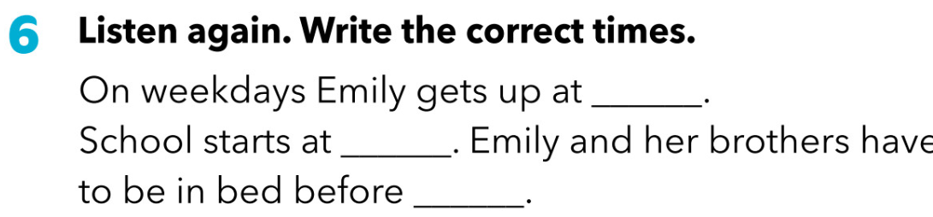
Listen again. Write the correct times.
https://www.e-sfera.hr/dodatni-digitalni-sadrzaji/a146555f-db3c-47d9-82f4-d3d49edac9cc/assets/audio/01_unit_01_lesson_1___emily_s_daily_routines.mp3
6.30
9
11

Slide 12
What do Paul and Emily have in common? What is different?
What about you? Say something about:
your home town
your family
what you do on weekdays
what you do at the weekends

Slide 13

Check for more!
https://www.bookwidgets.com/play/WH4GH7

Slide 14
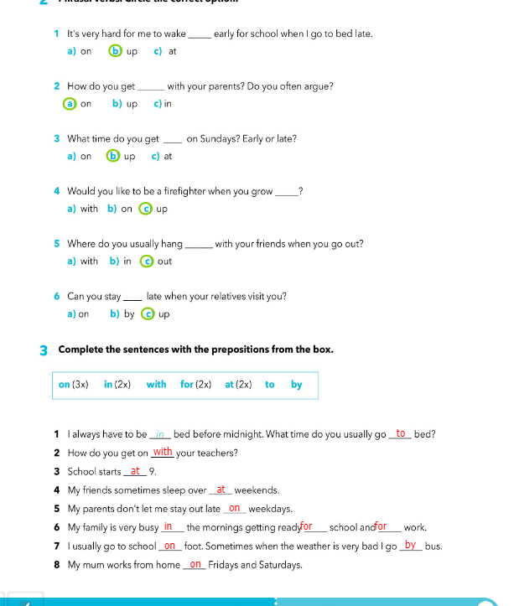
Workbook p.7.

Slide 15
Pripremi usmeno ili pismeno nekoliko rečenica o sebi imajući na umu podatke iz tekstova o Paulu i Emily (place, family, school, breakfast, weekday activities, weekend activities)!
A YouTuber’s day
https://www.e-sfera.hr/dodatni-digitalni-sadrzaji/a146555f-db3c-47d9-82f4-d3d49edac9cc/

